Slide 1
Open science and research reproducibility
Marcus Munafò

Slide 2
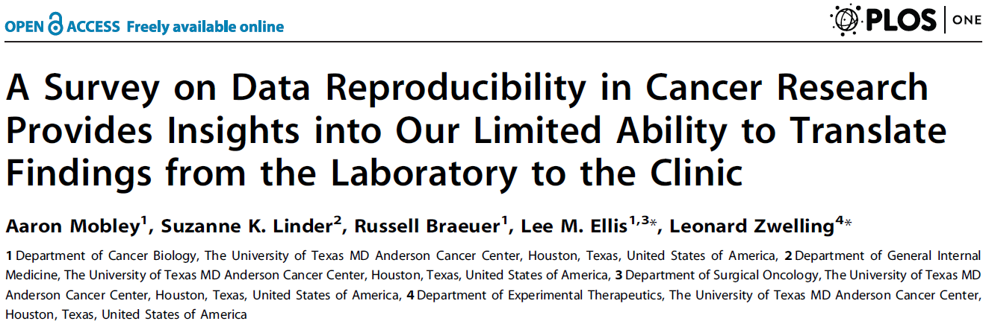
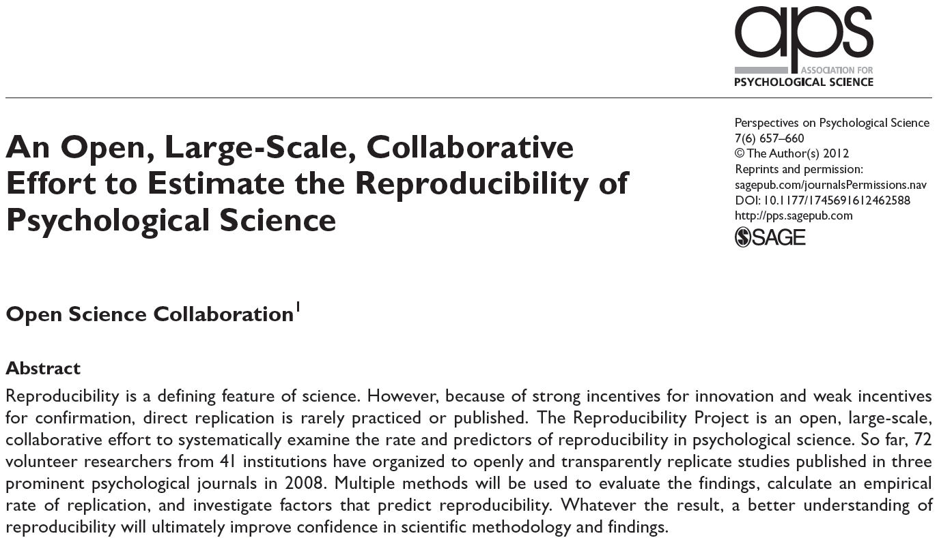
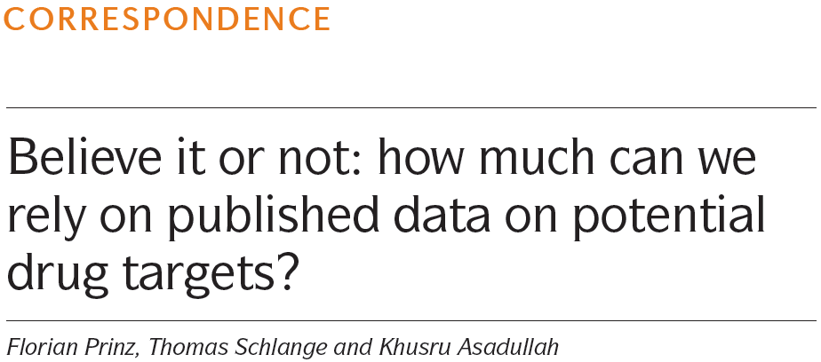

Slide 3
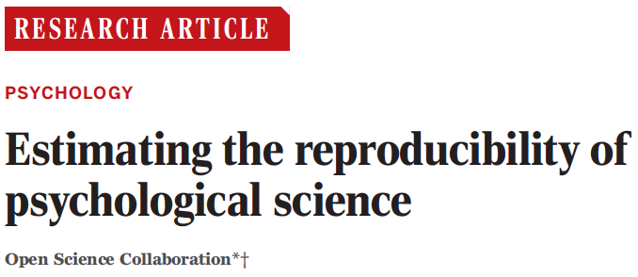
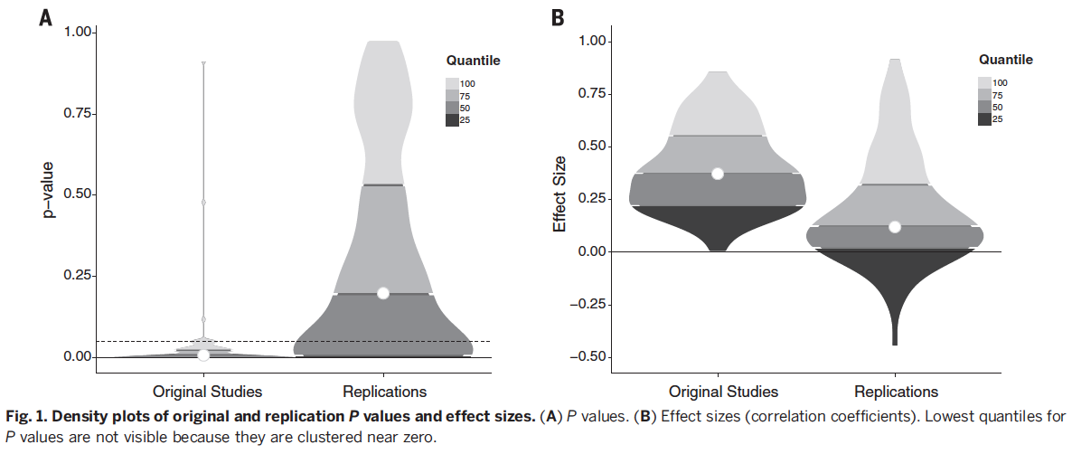
Open Science Collaboration (2015). Science, 349.

Slide 4
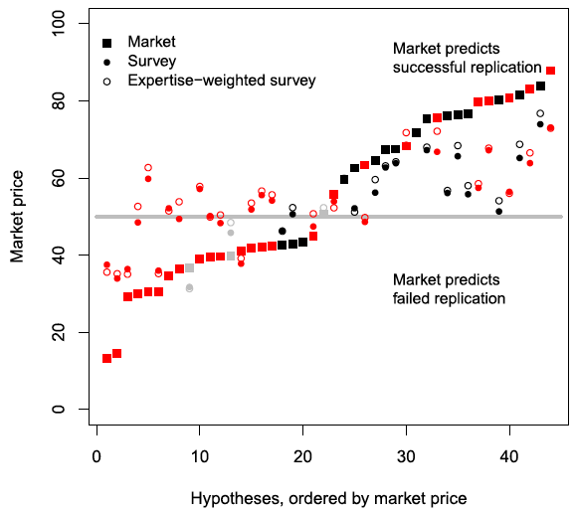
Prediction market on the outcomes of the Reproducibility Project: Psychology
Successful replications are shown in black, unsuccessful replications in red.
Dreber et al. (2015). PNAS, 112, 15343-15347.

Slide 5

  “Scientists may be in the business of laughing at their predecessors, but owing to an array of human mental dispositions, few realize that someone will laugh at their beliefs in the (disappointingly near) future”
Taleb (2007). Fooled by Randomness.

Slide 6
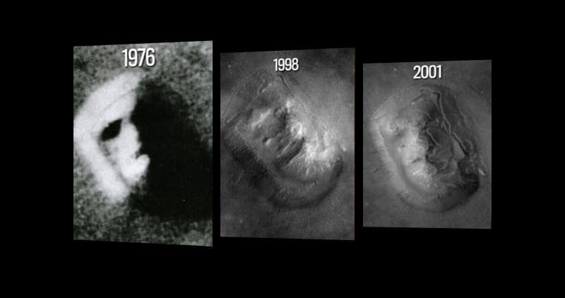

Slide 7

  “Certain features of the working environment of science may have unexpected and potentially detrimental effects on the ethical dimensions of scientists’ work”
Martinson et al. (2005). Nature, 435, 737-738.

Slide 8
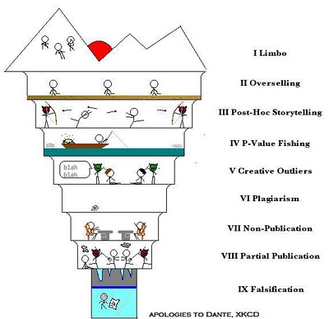
(i) Limbo
(ii) Overselling
(iii) Post-hoc storytelling
(iv) P-value fishing
(v) Creative outliers
(vi) Plagiarism
(viii) Non-publication
(viii) Partial publication
(ix) Falsification
Neuroskeptic (2012). Perspect Psychol Sci, 7, 643-644.

Slide 9

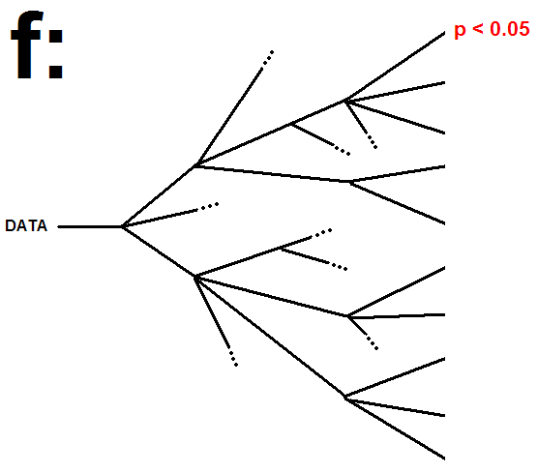
http://blogs.discovermagazine.com/neuroskeptic/2013/10/16/the-f-problem

Slide 10
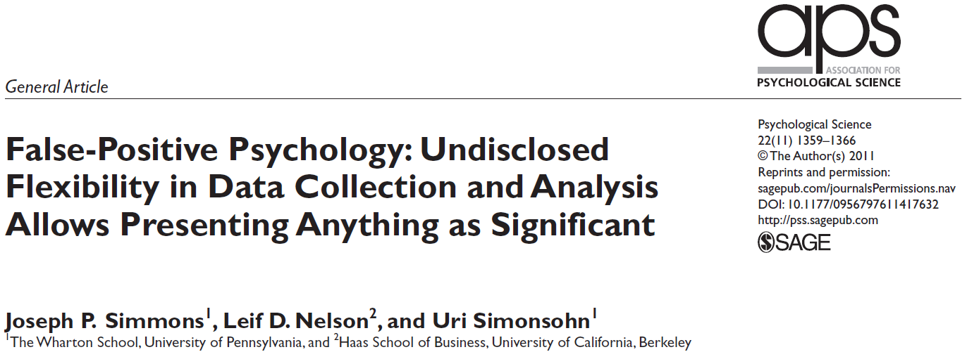
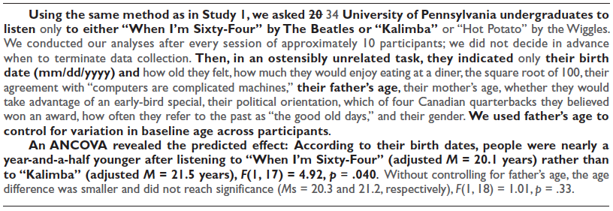
Simmons et al. (2011). Psychol Sci, 22, 1359-1366.

Slide 11
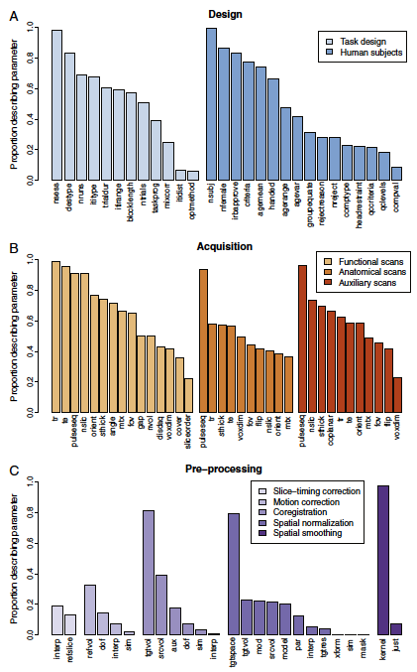
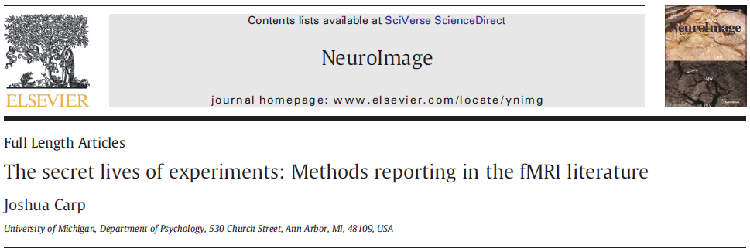
“…nearly as many unique analysis pipelines as there were studies in the sample…”
Carp (2012). Neuroimage, 63, 289-300.

Slide 12
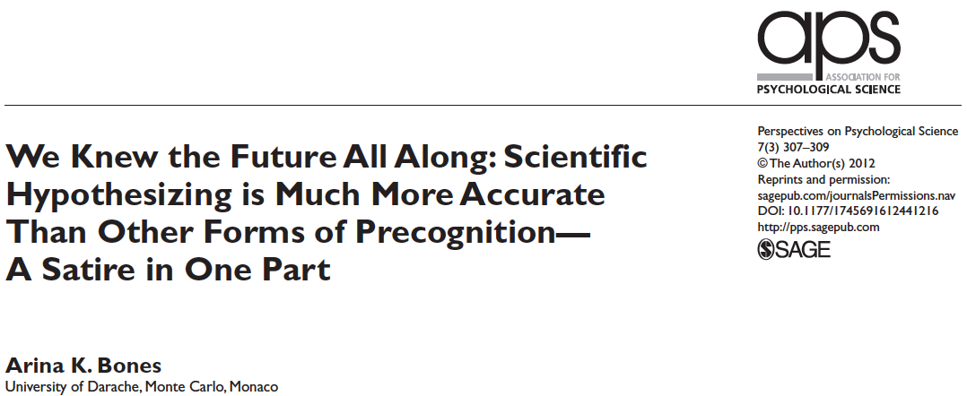
Incentive Structures
Bones (2012). Perspect Psychol Sci, 7, 307.

Slide 13
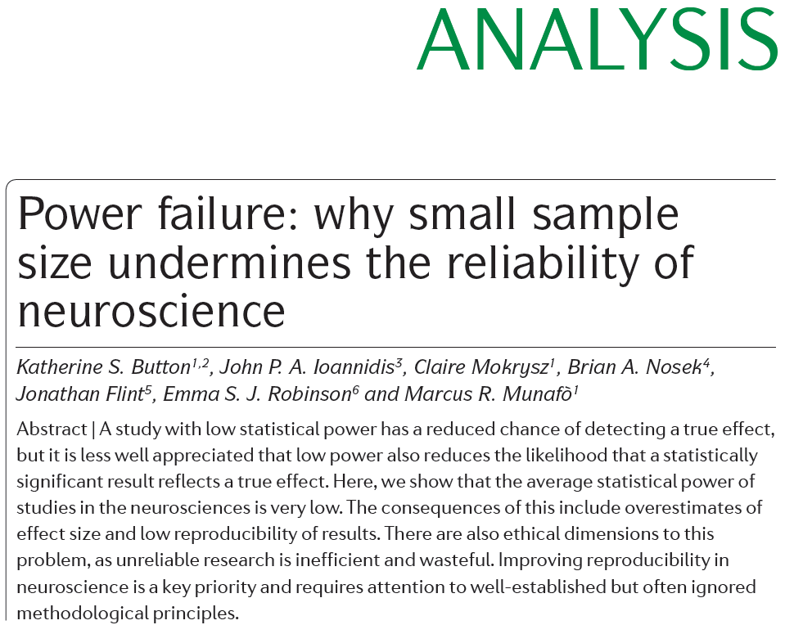
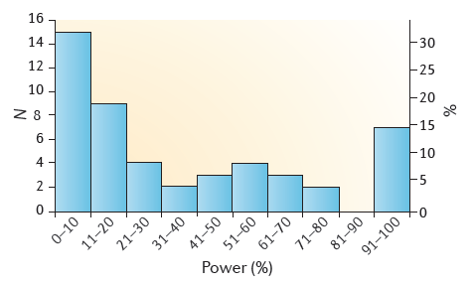
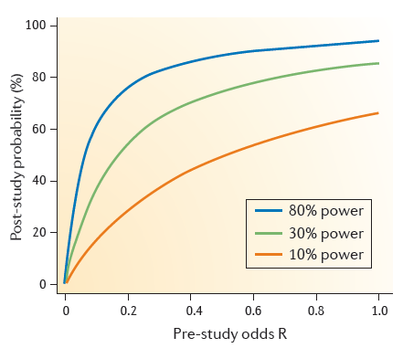
Incentive Structures
Button et al. (2013). Nat Rev Neurosci, 14, 365-376.

Slide 14
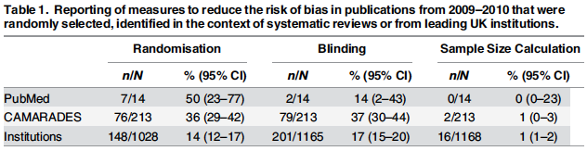
Studies from top-ranked UK institutions perform worse on reporting of measures to reduce the risk of bias than studies selected at random from PubMed…
Macleod et al. (2015). PLOS Biol, 13, e1002301.

Slide 15
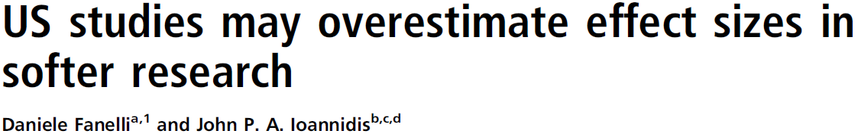
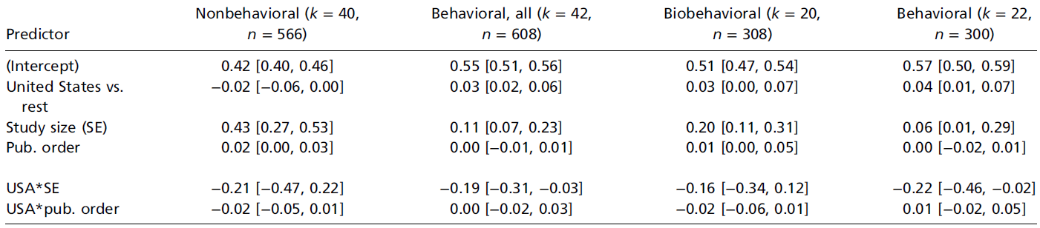
Fanelli & Ioannidis (2013). PNAS, 5, e10271.

Slide 16
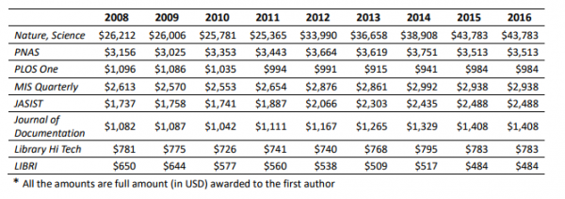

Slide 17
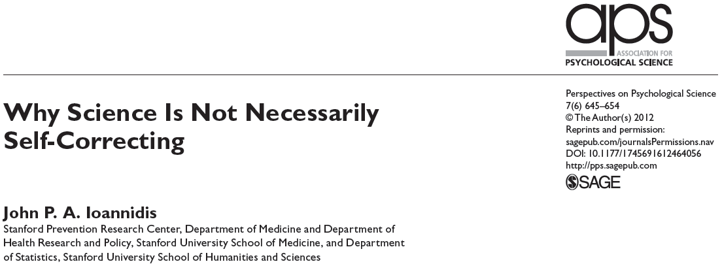
Ioannidis (2012). Perspect Psychol Sci, 7, 645-654.

Slide 18
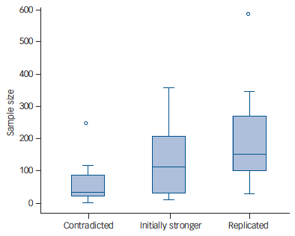
“Among 83 articles recommending effective interventions, 40 had not been subject to any attempt at replication…”
Tajika et al. (2015). Br J Psychiatry, 207, 357-362.

Slide 19
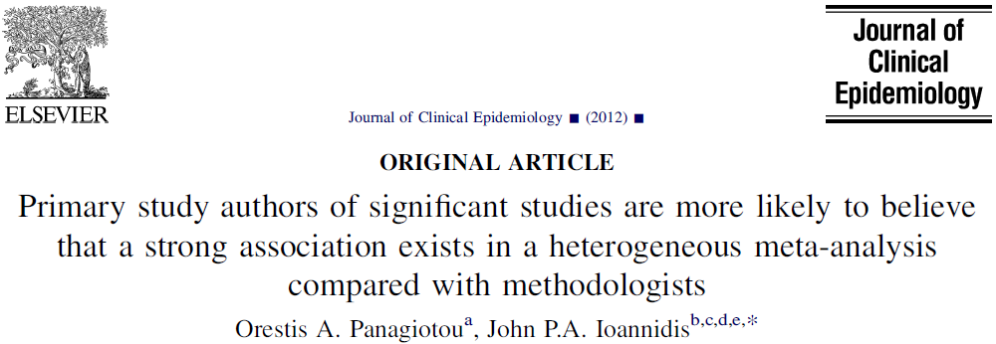
Panagiotou & Ioannidis (2012). J Clin Epidemiol, 65, 740-747.

Slide 20
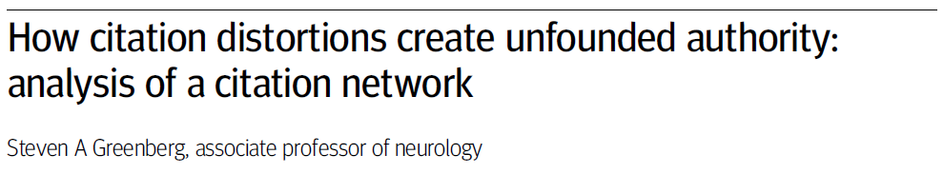
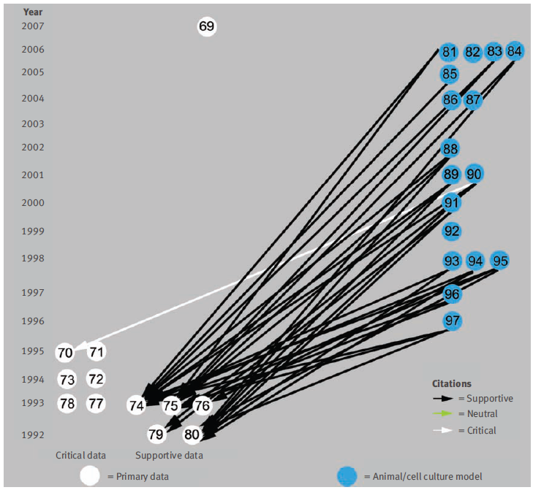
Investigated citation network of papers addressing the belief that B amyloid, a protein accumulated in the brain in Alzheimer’s disease, is produced by and injures skeletal muscle of patients with inclusion body myositis.
Greenberg (2009). Br Med J, 339, b2680.

Slide 21
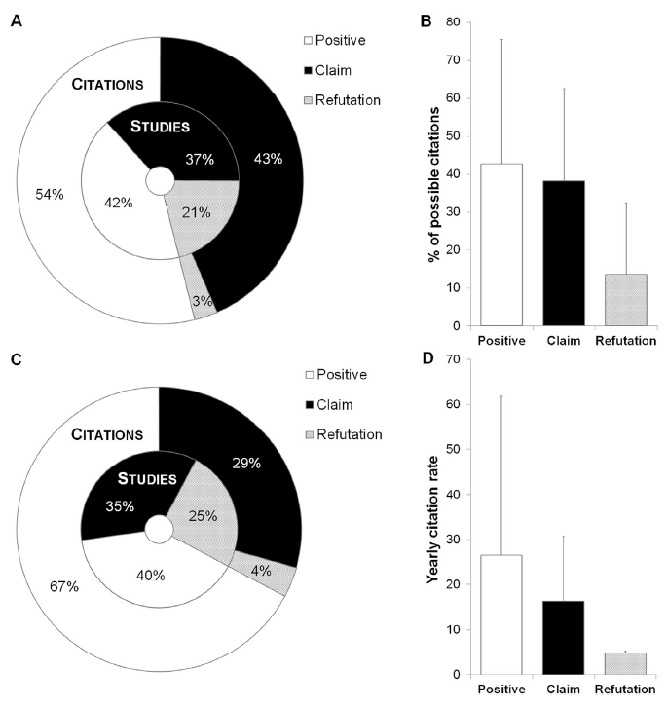
Abstracts often “spin” results to give impression that results are positive when they are not.
Citation inflation exists for both “positive” studies and “claim” studies in this literature.
True both within this literature (A, B) and in the wider (Web of Science) literature (C, D).
Bastiaansen et al. (2015). Biol Psychiatry, 78, e35-36.

Slide 22
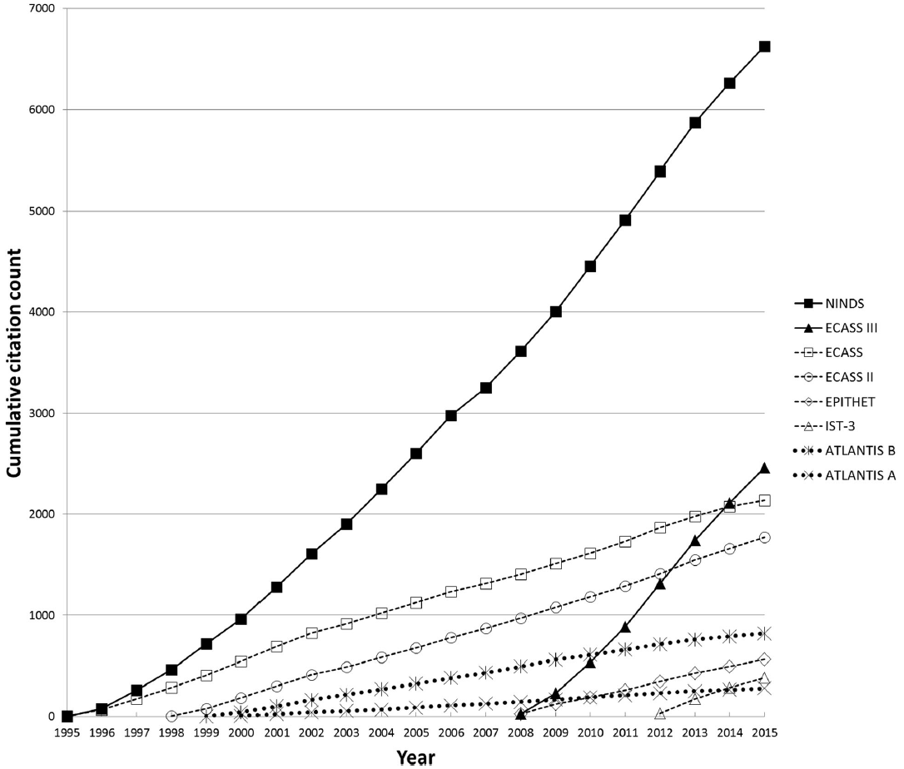
Two positive trials, four neutral trials, two negative trials (stopped early for safety concerns).
Misemer et al. (2016). Trials, 17, 473.

Slide 23
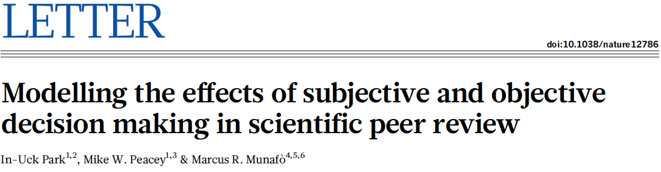
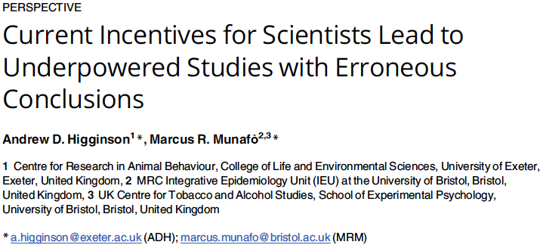
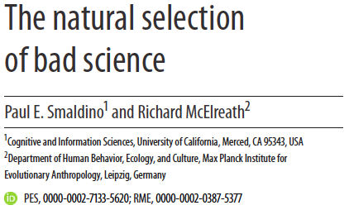

Slide 24
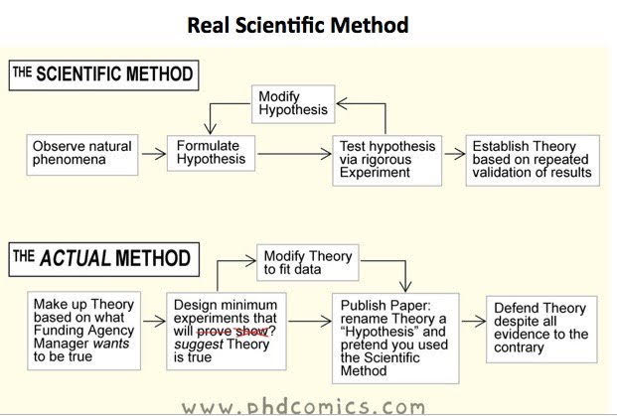

Slide 25
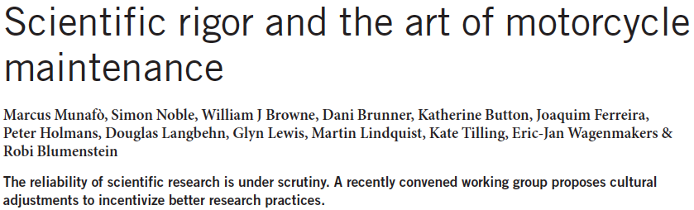
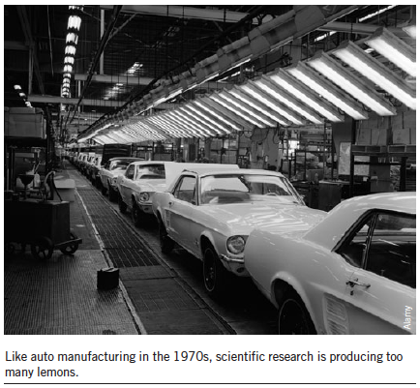
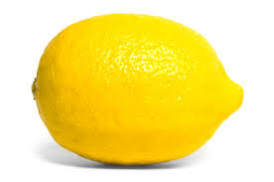
Munafò et al. (2014), Nat Biotech, 32, 871-873.

Slide 26
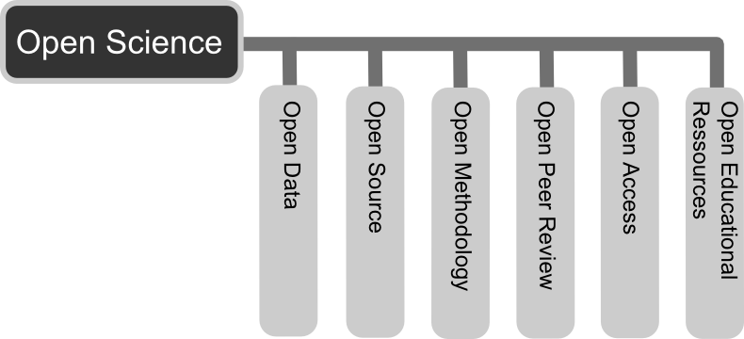


Slide 27
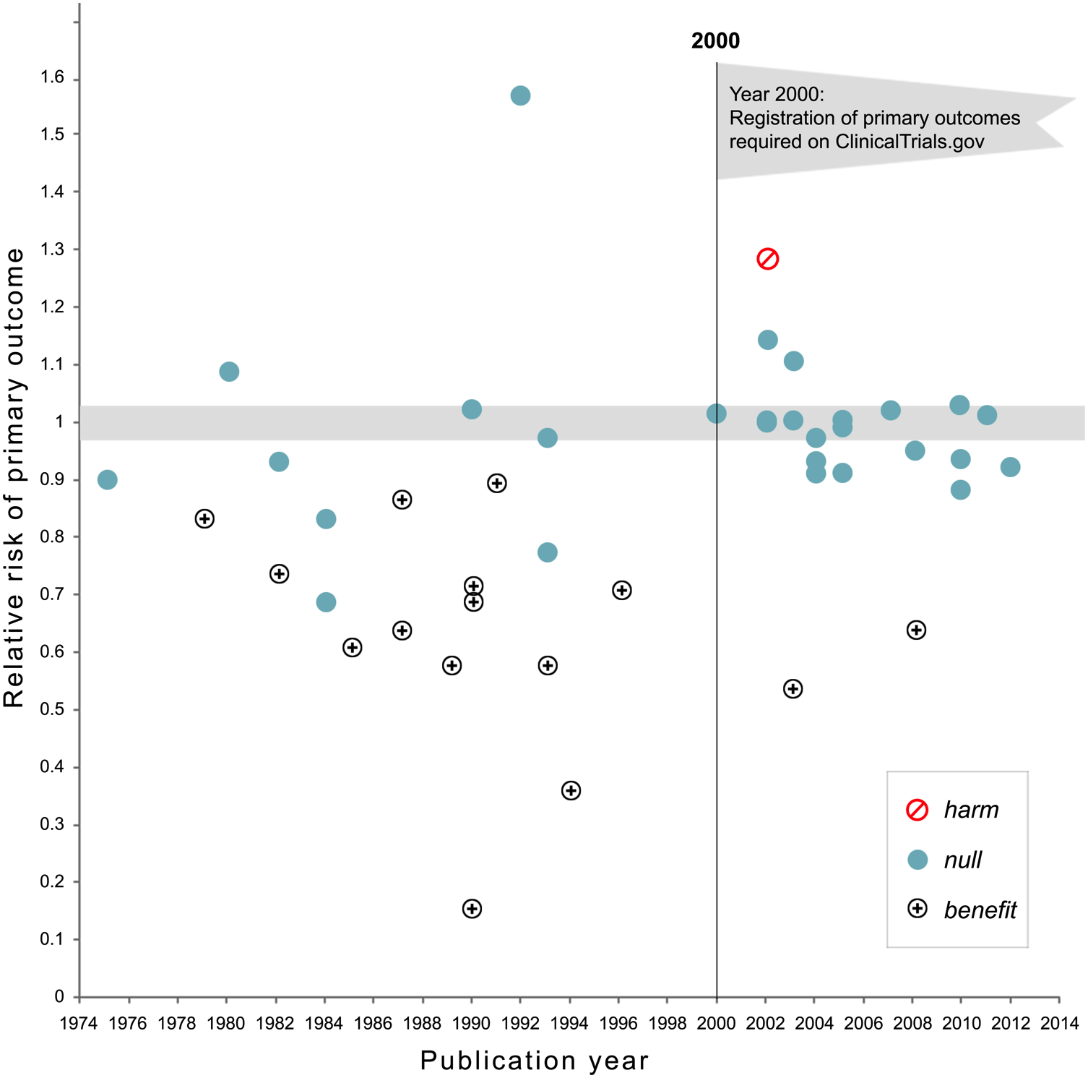
In 2000 the National Heart Lung, and Blood Institute required the registration of primary outcome on ClinicalTrials.gov for all their grant-funded activity
Kaplan & Irvin (2015). PLoS One, 10, e0132382.

Slide 28
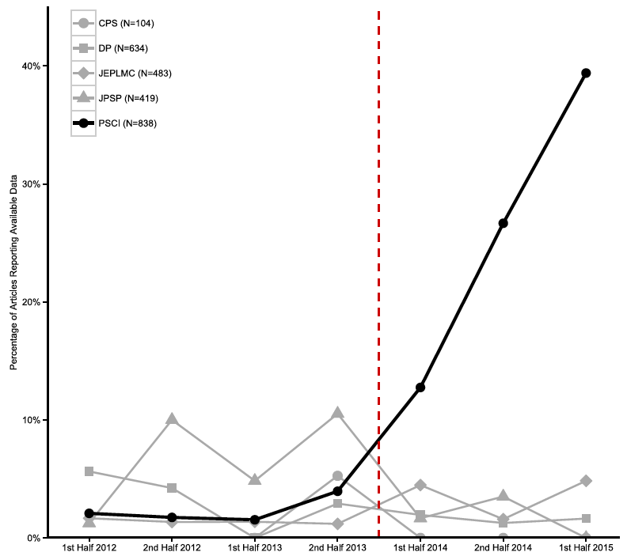



Introduction of badges for open practices at Psychological Science followed by a steep increased in data sharing.
Kidwell et al. (2016). PLoS Biology, 14, e1002456.

Slide 29
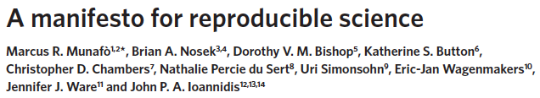
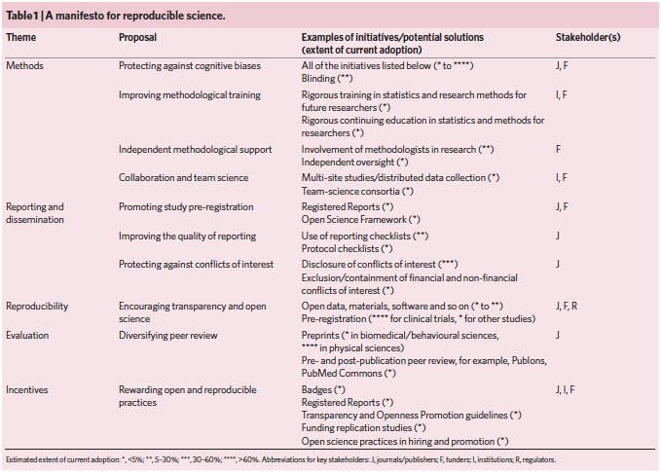
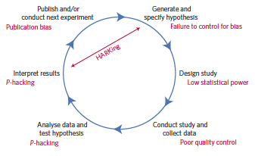
Munafò et al. (2017). Nat Hum Behav, 1, 0021.

Slide 30

Acknowledgements
Tobacco and Alcohol Research Group:
Angela Attwood Senior Lecturer
Anna Blackwell Postdoc
Laura Brocklebank Postdoc
Emily Crowe PhD Student
Perline Demange Research Assistant
Maddy Dyer PhD Student
Kayleigh Easey PhD Student
Andy Eastwood PhD Student
Meg Fluharty PhD Student
Elis Haan PhD Student
Eleanor Kennedy PhD Student
Jasmine Khouja PhD Student
Glenda Lassi Postdoc
Rebecca Lawn PhD Student
Jim Lumsden PhD Student
Olivia Maynard Lecturer
Sarah Peters PhD Student
Vicky Rice PhD Student
Laura Schellhas PhD Student
Hannah Sallis Postdoc
Carlos Sillero Research Assistant
Andy Skinner Postdoc
Giulia Sorrentino Research Assistant
Chris Stone Research Assistant
Steph Suddell PhD Student
Gemma Taylor Postdoc
Jorien Treur Postdoc
David Troy PhD Student
Robyn Wootton Postdoc
marcus.munafo@bristol.ac.uk
@MarcusMunafo
@BristolTARG
http://www.bristol.ac.uk/expsych/research/brain/targ
http://www.bris.ac.uk/expsych/events/reproducibility2018/

Slide 31
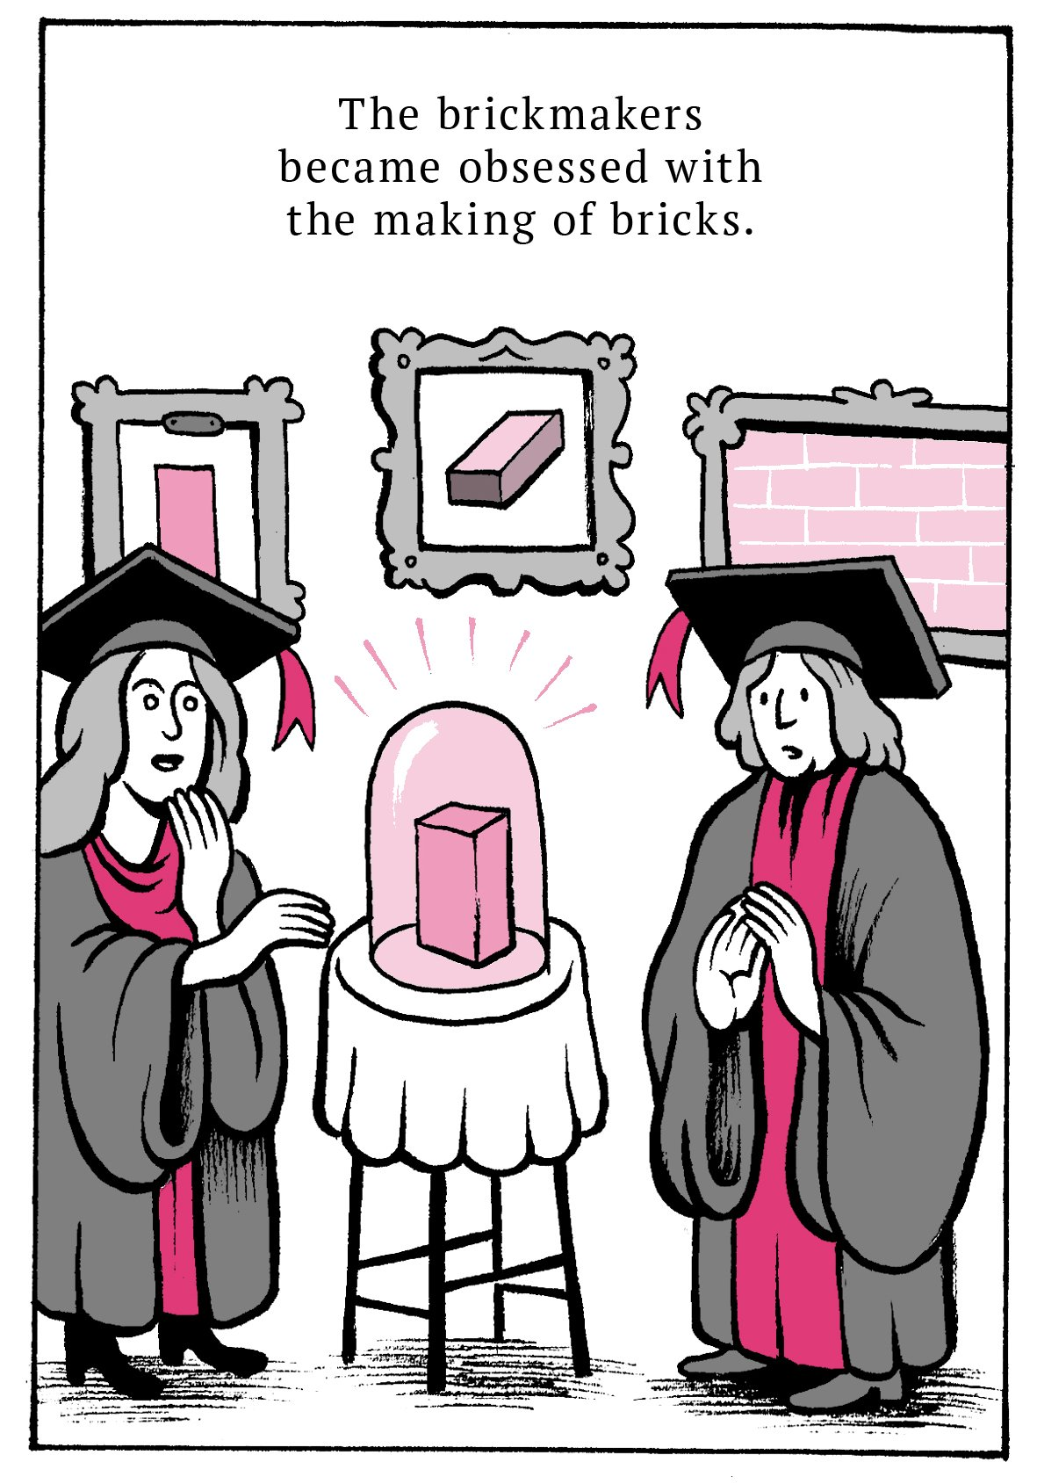
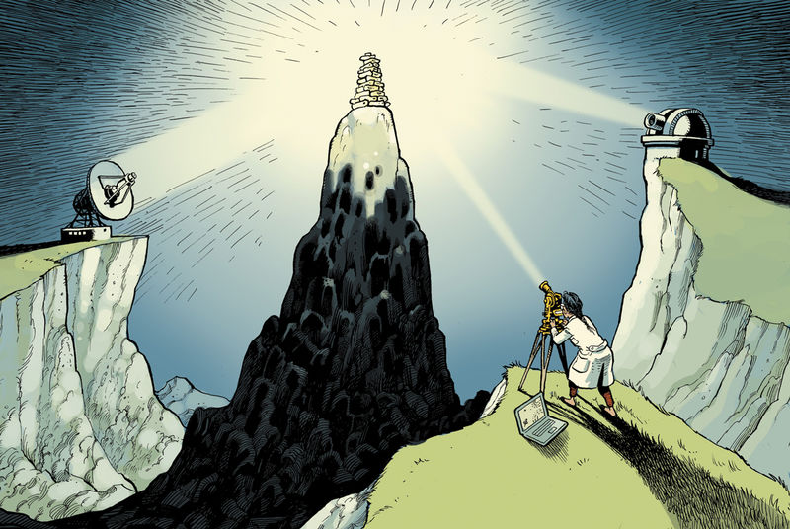
Beyond Replication…
Cartoon: Matteo Farinella

Slide 32
Pre-registration of study protocols…
Protects against HARKing
Reduces P-hacking
Protects against publication bias
Increases the risk of being “scooped”
Makes exploratory research impossible

Slide 33
Sharing research data…
Enables efficient re-use
Acts as a quality control measures
Protects against publication bias
Allows others to profit from your hard work
Makes commercialisation of research harder

Slide 34
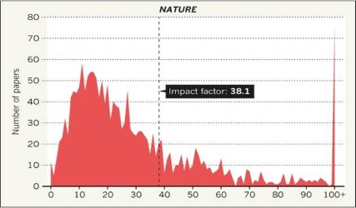

Slide 35
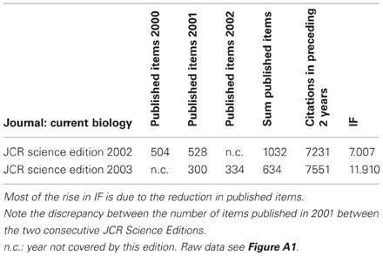

Slide 36
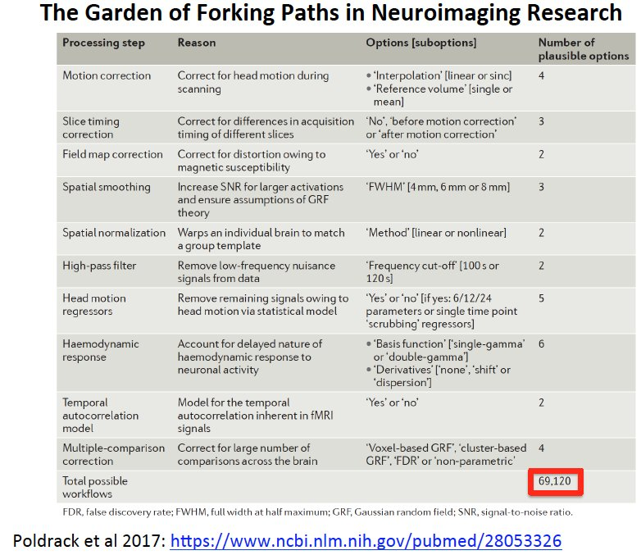

Slide 37
Munafò et al. (2010). Biol Psychiatry, 67, e21-e23.

Slide 38
Munafò et al. (2010). Biol Psychiatry, 67, e21-e23.

Slide 39
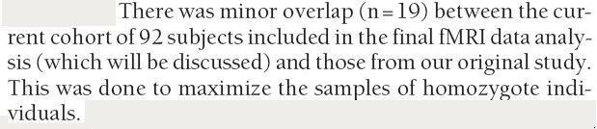

Slide 40
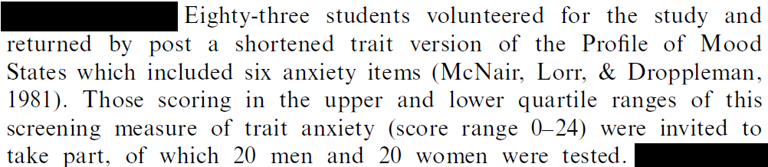
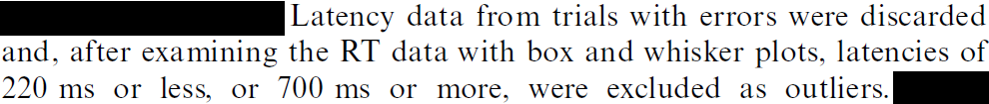
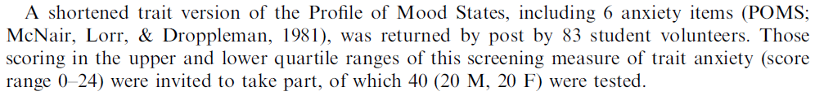

Slide 41






Slide 42




Questionable Practices

